Slide 1



18- Explaining Digital Forensics

Slide 2
Outlines
18.1- Explain Key Aspects of Digital Forensics Documentation

Slide 3
KEY ASPECTS OF DIGITAL FORENSICS
Digital forensics is the practice of collecting evidence from computer systems to a standard that will be accepted in a court of law.
Forensics investigations are most likely to be launched against crimes arising from insider threats, notably fraud or misuse of equipment (to download or store obscene material, for instance).
Like DNA or fingerprints, digital evidence is latent.
Latent means that the evidence cannot be seen with the naked eye; rather, it must be interpreted using a machine or process.
As well as the physical evidence (a hard drive, for instance), digital forensics requires documentation showing how the evidence was collected and analyzed without tampering.

Slide 4
DIGITAL FORENSICS REPORTS
A digital forensics report summarizes the significant contents of the digital data and the conclusions from the investigator's analysis.
It is important to note that strong ethical principles must guide forensics analysis.
Analysis must be performed without bias.
Conclusions and opinions should be formed only from the direct evidence under analysis.
Analysis methods must be repeatable by third parties with access to the same evidence.
Ideally, the evidence must not be changed or manipulated.

Slide 5
E-DISCOVERY
A forensic examination of a device such as a fixed drive that contains Electronically Stored Information (ESI) entails a search of the whole drive (including both allocated and unallocated sectors, for instance).
E-discovery is a means of filtering the relevant evidence produced from all the data gathered by a forensic examination and storing it in a database in a format such that it can be used as evidence in a trial.

Slide 6
VIDEO AND WITNESS INTERVIEWS
The first phase of a forensics investigation is to document the scene.
The crime scene must be recorded using photographs and ideally audio and video.
Investigators must capture every action they take in identifying, collecting, and handling evidence.
Remember that if the matter comes to trial, the trial could take place months or years after the event.
It is vital to record impressions and actions in notes.
Also consider that in-place CCTV systems or webcams might have captured valuable evidence.

Slide 7
TIMELINES
A significant part of a forensic investigation will involve tying events to specific times to establish a consistent and verifiable narrative.
The visual representation of events happening in chronological order is called a
timeline.
Operating systems and file systems use a variety of methods to identify the time at which something occurred.
The benchmark time is Coordinated Universal Time (UTC), which is essentially
the time at the Greenwich meridian.

Slide 8
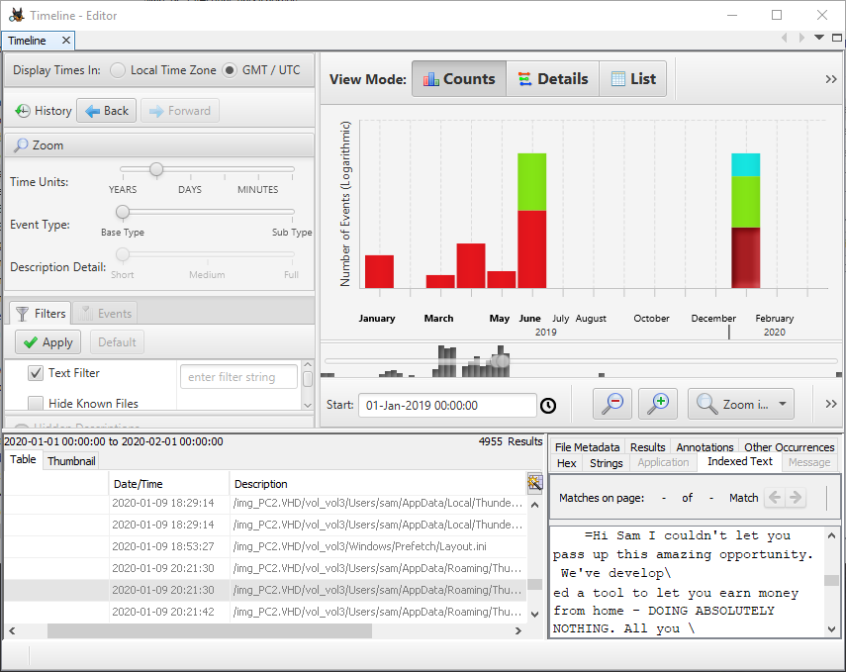
TIMELINES (cont.)

Slide 9
EVENT LOGS AND NETWORK TRAFFIC
Digital evidence is not just drawn from analysis of host system memory and data drives.
An investigation may also obtain the event logs for one or more network
appliances and/or server hosts.
Similarly, network packet captures and traces/flows might provide valuable evidence.
On a typical network, sensor and logging systems are not configured to record all
network traffic, as this would generate a very considerable amount of data.
On the other hand, an organization with sufficient IT resources could choose to preserve a huge amount of data.

